Slide 1
Webhooks
Version 1.0 – November 2019
André Borges

Slide 2
Different Scenarios
Individual webhooks processing or self-contained webhooks. The operations executed by each background service are self contained to the product, meaning that each program is only going to process their own webhooks events.
Multiple webhooks processing, for example a service that processes all JASMIN services webhooks.
The implementation is the same, the only difference is that on that multiple scenario the processing is done outside the services and on the individual scenario it is done inside the service, running parallel to the other tasks.

Slide 3
Middleware pipeline
The goal is to create a NuGet package (library) that can be added to the Lithium service design.
The middleware will expose two routes, one for the webhooks events and another one for the webhooks events subscriptions, with the route of, for example, /.webhooks and /.webhooks/subscription, respectively.
Aside from the middleware configuration it will also configure services to extend the service ServiceCollection.

Slide 4
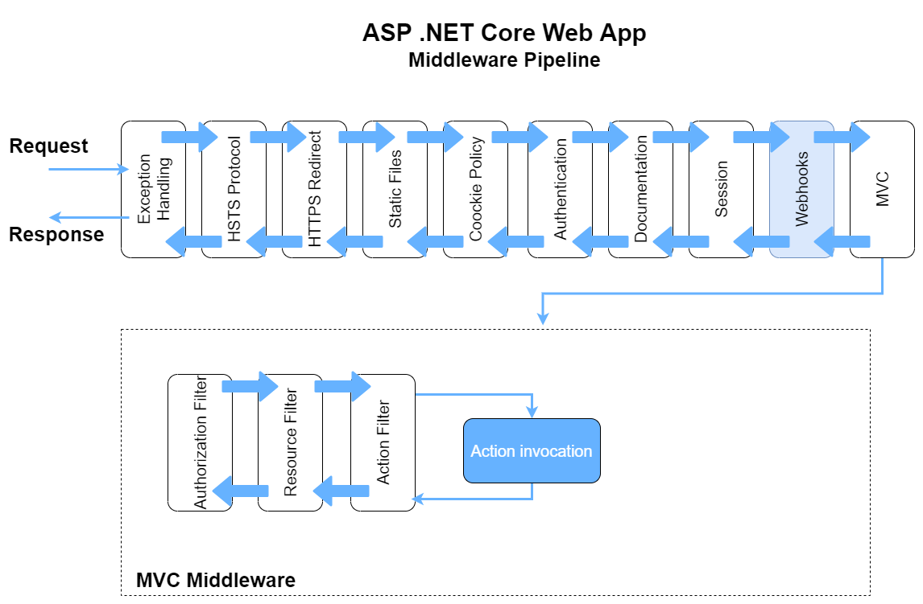

Slide 5
Webhooks ServiceCollection
services.AddWebhooksServices((options) =>
{
options.EventBus.ConnectionString = EBCS;
options.TableStorage.ConnectionString = TSCS;
options.ServiceNamespace = hostConfiguration.Information.HostTitle;
options.Product = hostConfiguration.Information.HostTitle;
options.RegisterWebhook(EventName, Description, RequiredScope);
});
The abstraction type used for the EventBusOptions and TableStorageOptions is the Hydrogen one.
The Webhooks registration could be made on the Lithium service design and posteriorly new webhooks events could be registered by either the same method or extending the base class.
In the future it would be useful to create filters to customize the webhooks querying.

Slide 6
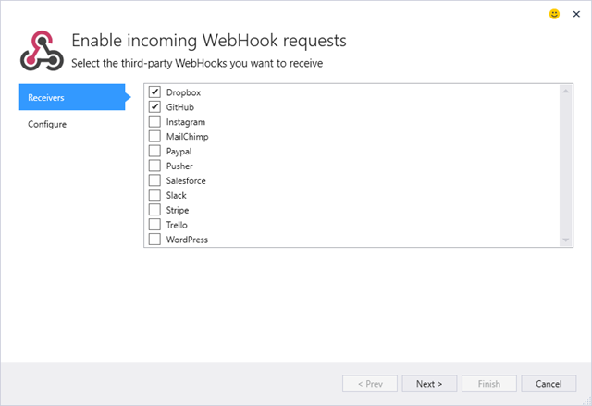

Slide 7
Background Services
protected override void AddBackgroundServices(IServiceCollection services, HostConfiguration hostConfiguration)
{
services.AddWebhooksBackgroundServices();
}
Goes to the table storage and picks up all the subscriptions for an event that was triggered and propagates the event payload to all the subscribers.
If the event was successfully sent to the subscriber it will be registered as successful on the database WebhooksEventLog table, otherwise it will retry to send it to the subscriber until he successfully receives it.

Slide 8
Event Bus
The event bus subscription is going to be made on the Startup class.
Since the topic for the event bus has to be previously created we can not create a new one on-demand, plus, to better organize our partitioning, the different subscriptions are going to be identified as filters.
Every time an endpoint is called and an action is triggered, if it is registered as an webhook event, an event is going to be published.

Slide 9
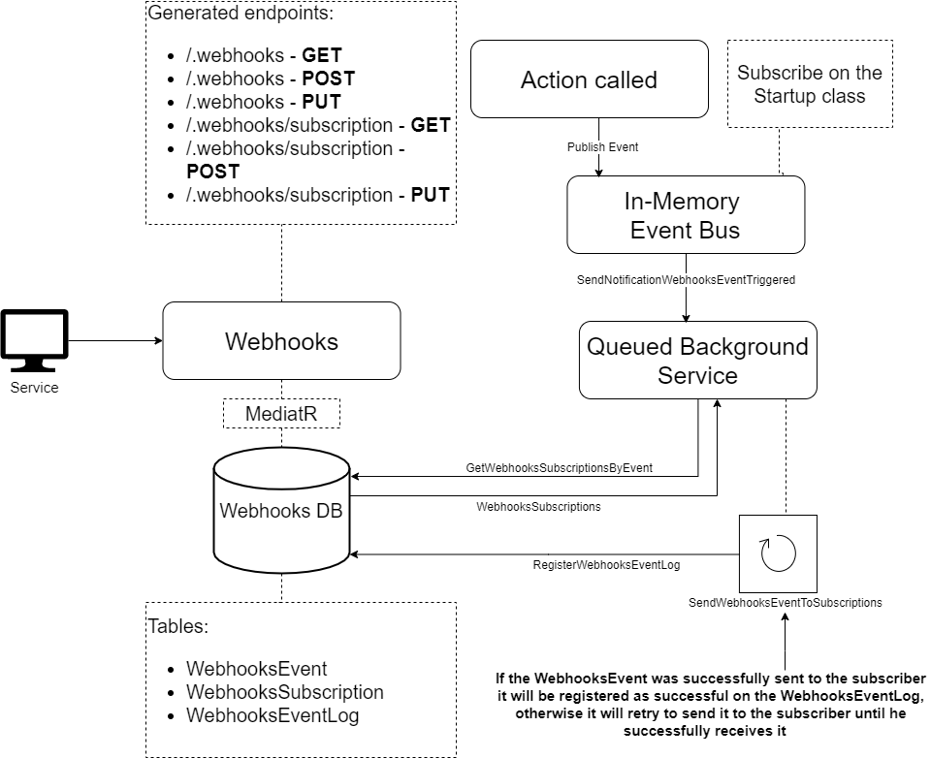

Slide 10
In the future
Nowadays the services are not heavy demanding, however, in the future if they do become, we can create a webhooks service to aggregate all the individual webhooks processing in one place.
This will remove the processing power from inside of the service to the outside, making them work as the multiple webhooks processing but without having anything in common.
In order to be easier to manage our webhooks and to not create bottlenecks we can scale the service making use of data partitioning with individual databases by partition.

Slide 11
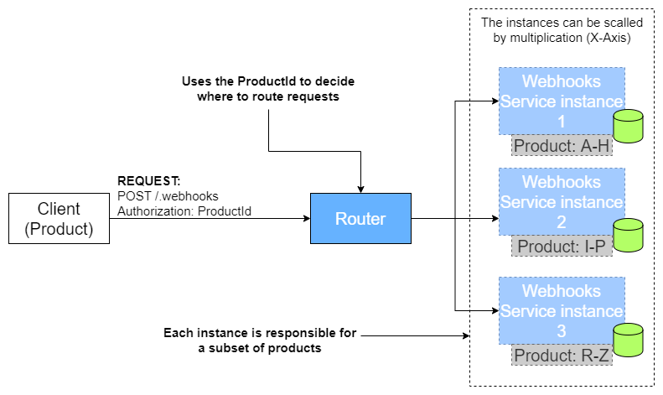

Slide 12
THE END

